Slide 1
MongoDB Relational Queries
JITHIN JOSE

Slide 2
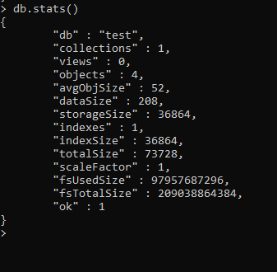
Statistics of database before insertion of documents

Slide 3
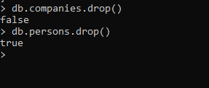
Dropping collection

Slide 4
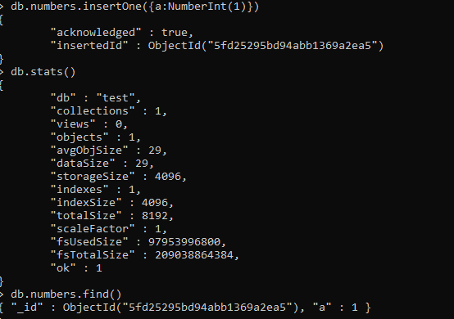
Data insertion and checking in db statistics

Slide 5
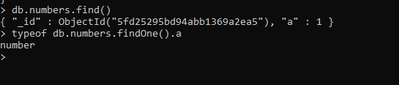
Displaying the datatype of a variable

Slide 6
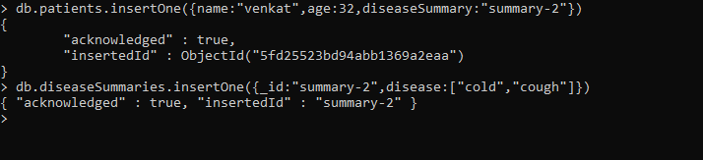
Patient-disease Relationship

Slide 7
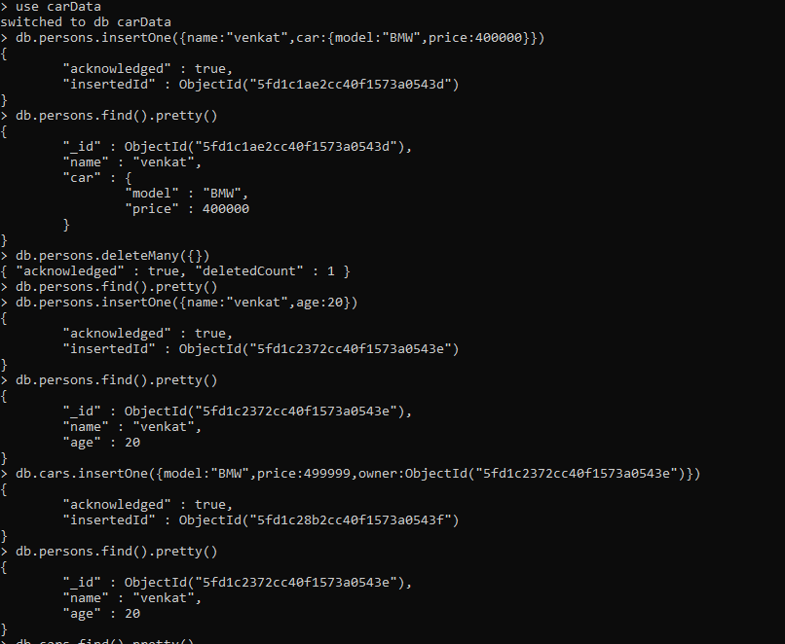
One-to-one (person-car) relationship

Slide 8
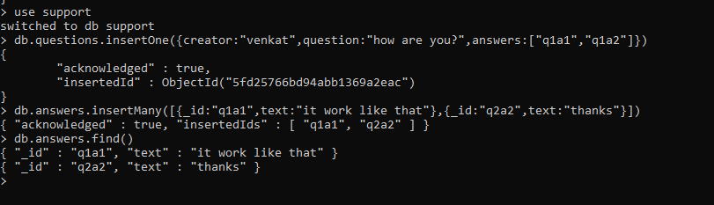
One-to-many(Thread-Answers) relationship

Slide 9
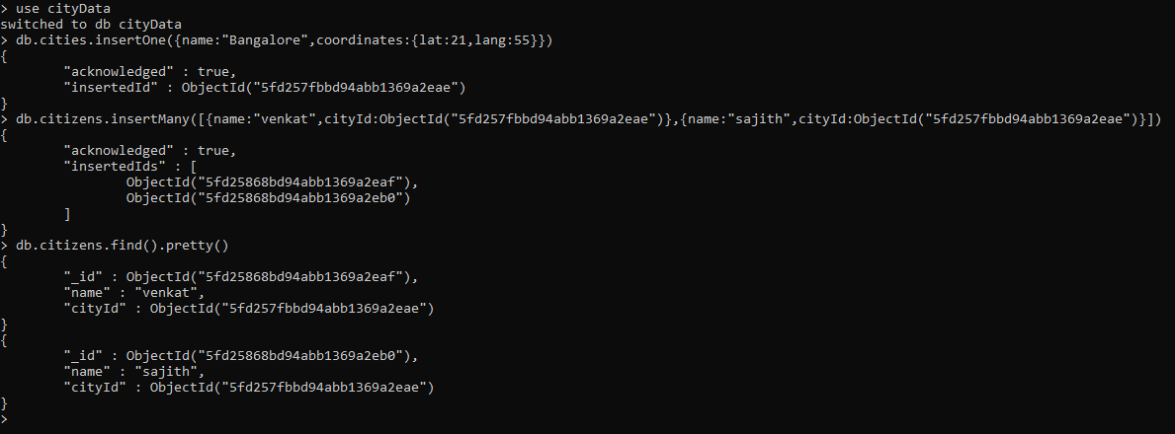
One-to-many with references

Slide 10
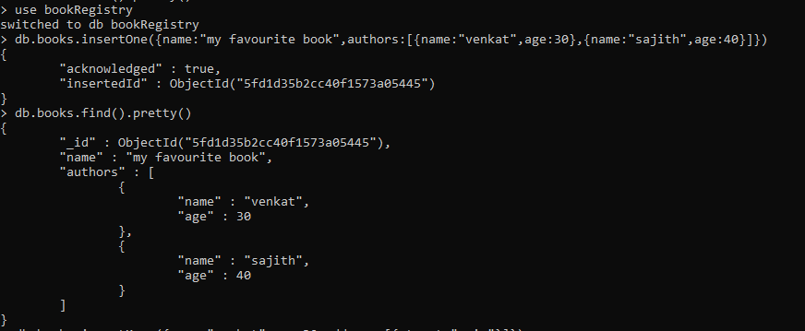
Many-to-many (books-authors) relationship

Slide 11
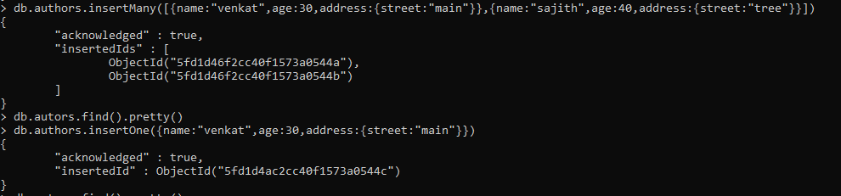

Slide 12
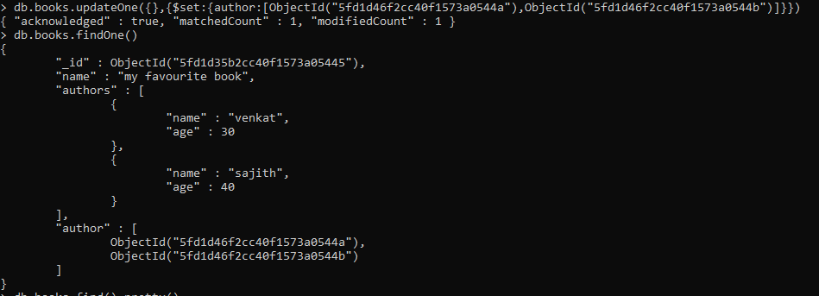

Slide 13
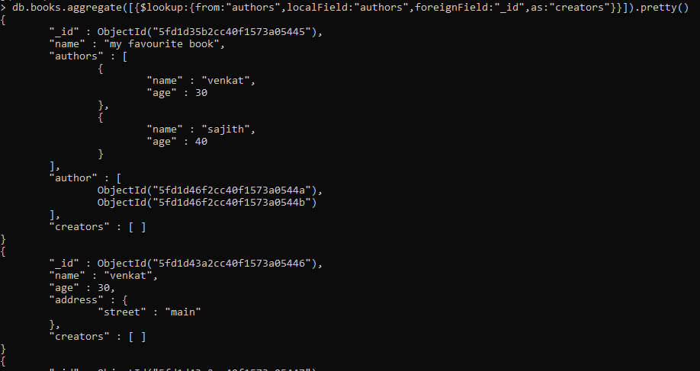
Joining two tables with lookup

Slide 14
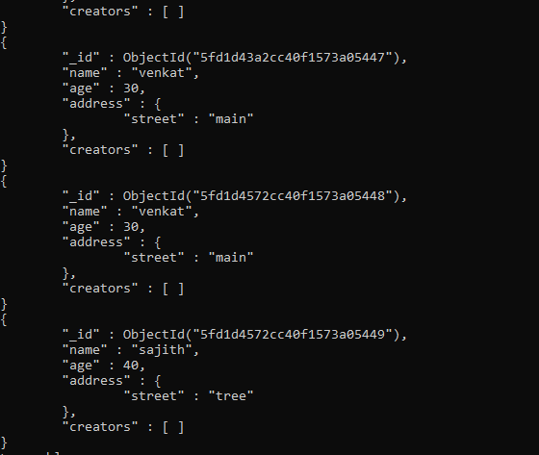

Slide 15
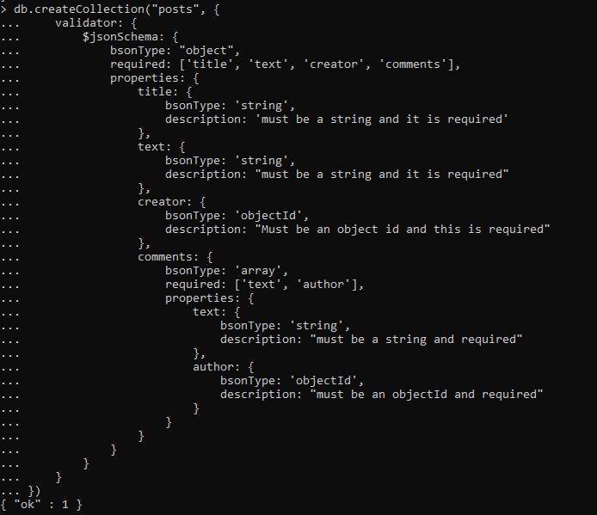
createCollection schema

Slide 16
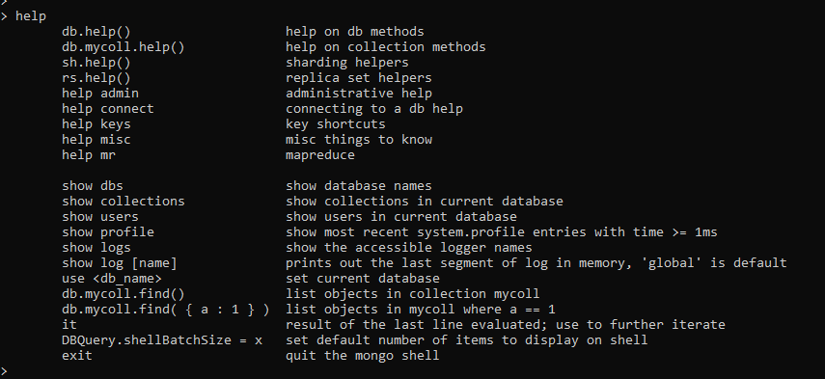
Help

Slide 17
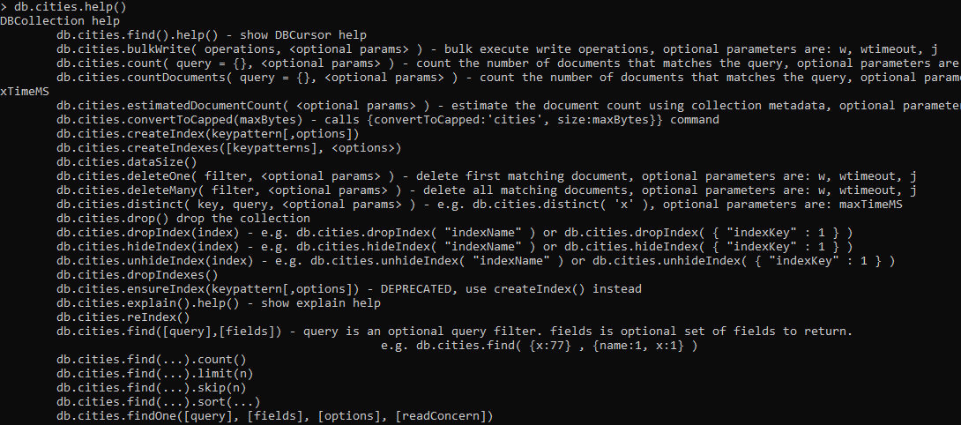
DB Collection help

Slide 18
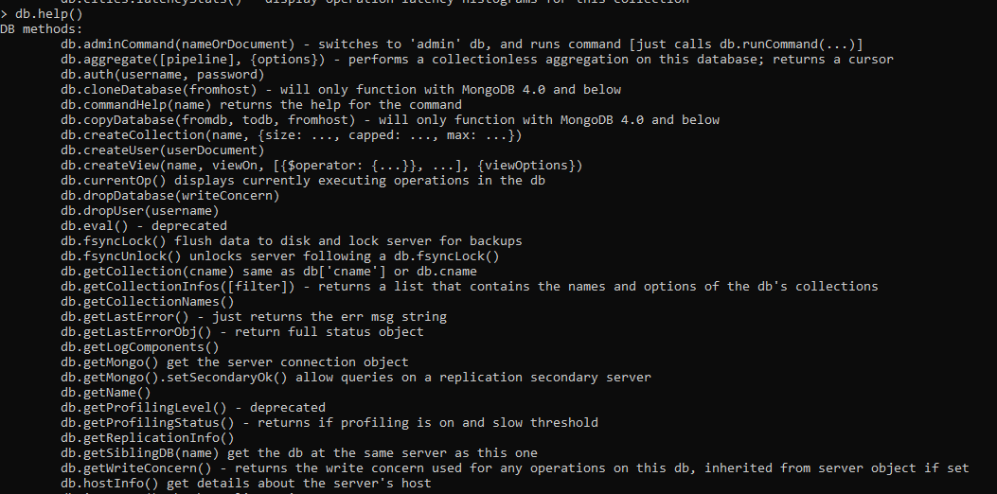
db.help()

